Slide 1
Why Information Systems?
For many years, Information was not considered an important asset for a firm. The management process was considered
a fact-to-face, personal art and
not a far-flung, global coordination process – involving customers, suppliers and business partners as well.
But today few managers can afford to ignore how information is handled by their organization.

Slide 2
Computers are the core component of Information Systems.
Over the past decade, more powerful and easy-to-use computers with graphical user interfaces are emerging while their prices continue to drop significantly.
This has had a major impact on all kinds of organizations or businesses.
On-line course registration
e-mail communication
mobile phones use
One fact about the Information and Communications Technology (ICT) industry is its fast changing nature.

Slide 3
There have been three major worldwide changes that has brought about a number of new challenges as well as opportunities to business firms and their management.
These changes have made the need for appropriate Information Systems even more critical.
The changes are:

Slide 4
Globalization of the World’s industrial Economies
how successful firms are today and will be in the future depends on their ability to operate globally and this is only possible using Information Systems (IS) that provide the communication and analytical power that is needed for conducting trade and managing business on a global scale.
To operate globally, one needs to
Communicate with its distributors and suppliers
Operate 24 hrs a day in different national environments
Service local and international reporting needs.
using powerful Information Systems.

Slide 5
Globalization and Information Technology (IT) also bring new threats to domestic business.
Customers now can shop in a worldwide marketplace, obtaining price and quality information reliably, 24 hours a day, heightening competition and forcing firms to play in open, unprotected worldwide markets. To become effective and profitable participants in international markets, firms need powerful Information and Communication systems.
Powerful Information and Communication systems are needed by firms to become effective and profitable participants in international markets

Slide 6
The Creation of Knowledge-and-information-based Economies.
The major industrial powers are experiencing a third economic revolution - a knowledge-and-information-based service economy, where jobs primarily involve working with, distributing, or creating new knowledge and information.
The US for example transformed itself from a colonial backwater to an agrarian powerhouse by the end of the nineteenth century.
By 1920, the US transformed itself from an agrarian nineteenth-century society to a first-class industrial power.
In the third revolution, which is now in progress, the U S and the major industrial powers are transforming themselves into a knowledge-and-information-based service economy.

Slide 7
In a knowledge-and-information-based economy, IT and Information Systems take on great importance.
Management’s decisions about IT are critically important to the prosperity and survival of a firm because the productivity of its employees will depend on the quality of the information systems serving them.
Also, new services of great economic value such as the use of credit and ATM cards, and worldwide reservation systems are made possible as a result of the growing power of IT.
Information and the technology that delivers it have therefore become critical, strategic assets for organizations and their managers.

Slide 8
Transformation Of The Business Enterprise.
Traditionally, business firms were, and still are to a large extent, a hierarchical, centralized structured arrangement of specialists that typically relies on a fixed set of standard operating procedures to deliver a mass-produced product (or service).
The new style of business firms is a flattened (less hierarchical), decentralized, flexible arrangement of generalist who rely on nearly instant information to deliver mass-customized products and services uniquely suited to specific markets or customers.
Though still evolving, this new style of organization would be unthinkable without IT.

Slide 9
What is an Information System (IS)?
An Information System is any organized combination of people, hardware, software, communication networks, and data resources that collect, transform, and disseminates information to support decision-making and control in an organization.
Technically, an Information System can be defined as an information-technology based system designed to collect (or retrieve), process, store, and distribute information to support decision making and control in an organization..
Notes:
Information Systems also helps managers and workers analyse problems, visualize complex subjects, and create new products.
Information Systems also helps managers and workers analyse problems, visualize complex subjects, and create new products.

Slide 10
A company’s information system is a set of interrelated components that collects, process, store, and disseminate information to support the companies’ managerial team in decision making, coordination, control, and analyzing.
Information Systems contains information about significant people, places, and things within the organization or in the environment surrounding it.
Notes:
Information Systems also helps managers and workers analyse problems, visualize complex subjects, and create new products.
Information Systems also helps managers and workers analyse problems, visualize complex subjects, and create new products.

Slide 11
By Information, we mean data that have been shaped into a form that is meaningful and useful to human beings.
Data, in contrast, are streams of raw facts representing events occurring in organizations or the physical environment before they have been organized into a form that people can understand and use.
Activities in an IS that produce the information needed for making decisions, controlling operations, analysing problems, and creating new products or services are input, processing, output and feedback.

Slide 12
Feedback is output that is returned to appropriate members of the organization to help them evaluate or correct the input or processing stage.
INPUT
PROCESS
OUTPUT
FEEDBACK

Slide 13
Components of an Information System
We have noted that an information system is a system that accepts data resources as input and processes them into information products as output.
How does an information system accomplish this task?
What system components and activities are involved?

Slide 14
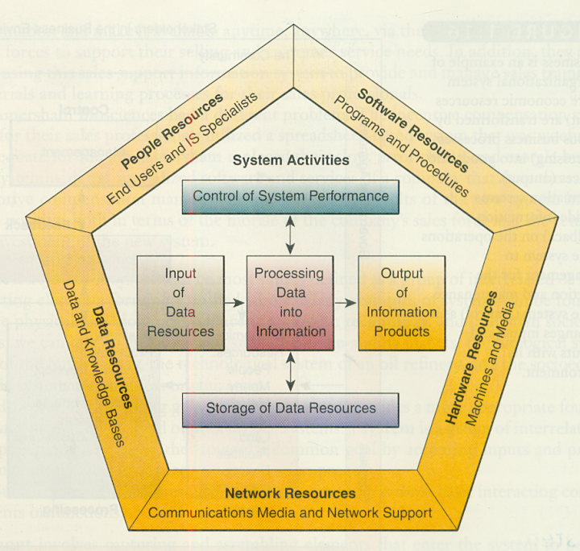
This is an information system model that expresses a fundamental conceptual framework for the major components and activities of information systems.

Slide 15
An information system depends on the resources of
people (end users and IS specialists),
hardware (machines and media),
software (programs and procedures),
data (data and knowledge bases), and
networks (communications media and network support)
to perform input, processing, output, storage, and control activities that transform data resources into information products

Slide 16
This information system model highlights the relationships among the components and activities of information systems.
It also provides a framework that emphasizes four major concepts that can be applied to all types of information systems:
Input
Processing
Output
Feedback

Slide 17
Data resources are transformed by information processing activities into a variety of information products for end users.
• Information processing consists of the system activities of
input,
processing,
output,
storage, and
control.

Slide 18
Formal, organizational Computer-Based Information Systems (CBIS).
Formal systems rest on acceptable and fixed definitions of data and procedures for collecting, storing, processing, disseminating, and using these data.
Formal systems are structured; that is, they operate in conformity with predefined rules that are relatively fixed and not easily changed.
Informal Information Systems (such as office gossips networks YESE-YESE)
These rely, by contrast, on implicit agreements and unstated rules of behaviour. There is no agreement on what is information, or on how it will be stored and processed. Such systems are essential for the life of an organization, but an analysis of their qualities is beyond the scope of this course

Slide 19
Formal Information Systems can be either computer-based or manual
Distinction between a computer , a computer program, and an information system.
Knowing how computers and computer programs work is important in designing solutions to organizational problems, but computers are only part of an Information Systems.
. The terms Management Information System (MIS) and Information System (IS) are often used interchangeably.
Notes:
To understand Information Systems, one must understand the problems they are designed to solve, their architectural and design elements, and the organizational process that lead to these solutions. Today’s managers must combine computer literacy with Information Systems literacy.

Slide 20
The components of a CBIS are the hardware, software, databases, telecommunications, people, and procedures that are configured to collect, manipulate, store, and process data into information.
To understand Information Systems, one must understand
the problems they are designed to solve,
their architectural and design elements, and
the organizational process that lead to these solutions.
Today’s managers must combine computer literacy with Information Systems literacy.
Notes:
To understand Information Systems, one must understand the problems they are designed to solve, their architectural and design elements, and the organizational process that lead to these solutions. Today’s managers must combine computer literacy with Information Systems literacy.

Slide 21
A Business Perspective on Information Systems
From a business perspective, an Information System is an organizational and management solution, based on IT, to a challenge posed by the environment
From the definition, it is important to recognize the organizational, management, and IT dimensions of information systems
Organization - Information Systems are part of organizations and all organizations have a purpose. Key elements of an organization are its people, structure and operating procedures, politics, and culture.
Notes:
. Formal organizations are composed of different levels and specialist. Their structures reveal a clear-cut division of labour. Experts are employed and trained for different functions, including sales and marketing, manufacturing, finance, accounting, and human resources.

Slide 22
Standard Operating procedures (SOPs) are formal rules for accomplishing tasks that have been developed over a long time
Organizations require many different kinds of skills and people.
Knowledge workers (such as engineers, architects, or scientists) design products or services and create new knowledge
Data Workers (such as secretaries, bookkeepers, or clerks) process the organization's paperwork.
Production or service workers (such as machinist, assemblers, or packers) actually produce the products or services of the organization.
Notes:
An organization coordinates work through a structured hierarchy and formal, standard operating procedures. The hierarchy arranges people in a pyramidal structure of rising authority and responsibility. The upper levels of the hierarchy consist of managerial, professional, and technical employers, whereas the lower levels consist of operating personnel.
. Most procedures are formalized and written down, but many others are informal work practices. Many of a firm’s SOPs are incorporated into Information Systems - such as how to pay a supplier or how to correct an erroneous bill.

Slide 23
Each organization has a unique culture – a fundamental set of assumption, values, and ways of doing things, that has been accepted by most of its members. Part of an organizations culture can always be found embedded in its Information Systems.
Different levels and specialists in an organization create different interest and points of view that may often conflict. Conflict is the basis of organizational politics. Information Systems come out of this cauldron of differing perspectives, conflicts, compromises, and agreements that are a natural part of all organizations.

Slide 24
Management - Managers
perceive business challenges in the environment;
they set the organizational strategy for responding,
And they allocate the human and financial resources to achieve the strategy and coordinate the work. These are the managers’ conventional responsibilities.
Further they must also create new products and services and even re-create the organization from time to time
This creative work is driven by new knowledge and information and IT can play a powerful role in redirecting and redesigning the organization
Each level of management has different information needs and Information Systems requirements.

Slide 25
Technology - Information System technology is one of the many tools available to mangers for coping with change. CBIS uses computer hardware, software, storage and telecommunications technologies.

Slide 26
There are many different types of information systems:
Transaction Processing Systems
Enterprise Resource Planning Systems
Knowledge Management Systems
Management Information Systems
Decision Support Systems
Executive Support Systems
Specialized Business Information Systems (Artificial Intelligence, Expert Systems, Virtual Reality)

Slide 27
IS is therefore not simply about computers - it’s about how businesses can make the best use of computer technology to provide the information needed to achieve their goals.
In the same way as your own needs and priorities are unique to you, each organisation has different goals and requirements, and the successful implementation of IS requires a through understanding of the business issues involved, as well as the different technologies that are available.
Most of the time there is no single “correct answer”, and you will need to draw on your own knowledge and judgment when planning or using an information system.

Slide 28
Read on New Options for Organizational Design
Flatter Organizations
Separating Work from Location
Increase in Flexibility of Organizations
Redefinition of Organizational Boundaries and Electronic Commerce
Reorganization of Workflows

Slide 29
New options for organizational design
Information systems can become powerful instruments for making organisations more competitive and efficient
Flattening organizations
Flatter organisations have few levels of management, with lower-level employee being given greater decision making authority. These employees are empowered to make more decisions than in the past, they no longer work standard 9am-to-5pm, and they no longer necessarily work in offices. Moreover each employee may be scattered geographically, sometimes, working half a world away from the manager.

Slide 30
Modern information systems have made such changes possible.
They can make more information available to line workers so they can make it possible for employees to work together as a team
With the emergence of global networks like the internet, team members can collaborate closely even from distant locations.
These changes mean that the manager’s span of control has been broadened, allowing high level managers to manage and control workers spread over distances.

Slide 31
Separating work from the location
It is now possible to organise globally whiles working locally: information technologies like email, the internet, and video conferencing to the desktop permit tight coordination of geographically dispersed workers across time zones and cultures.
Modern telecommunication technology has eliminated distance as a factor for many types of work in many situations.
Collaborative teamwork across thousands of miles has become a reality as designers work on the design of new products even if they are located in different continents.

Slide 32
Companies are not limited to physical location for providing products and services. Networked information systems are allowing companies to coordinate their geographically distributed capabilities as virtual corporations (or virtual organisations), sometimes called networked organisations.
Virtual organisations use networks to link people, assets, and ideas, allying with suppliers and customers (and sometimes even competitors) to create and distribute new products and services without being limited by traditional organisational boundaries or physical location.

Slide 33
Increasing flexibility of organisations
Modern telecommunications technology has enabled many organisations to organise in more flexible ways increasing the ability of those organisations to respond to changes in the market place and to take advantage of new opportunities.
Information systems can give both large and small organisations additional flexibility to overcome some of the limitations posed by their size.
Small organisations use information system to acquire some of the muscle and reach of larger organisations.
Large organisations can use information technology to achieve some of the agility and responsiveness of small organisations.

Slide 34
Redefining organizational boundaries and electronic commerce
Telecommunications-based information systems enable transactions such as payments and purchase orders to be exchanged electronically among different companies. Organisations can also share business data, catalogues, or mail messages through such systems. These networked information systems can create new relationships between an organisation, its customers and suppliers, redefining their organisational boundaries.
Systems linking a company to its customers, distributors, or suppliers are termed interorganisational systems because they automate the flow of information across organisational boundaries

Slide 35
The Internet is creating a global electronic market place where a vast array of goods and services are being advertised, bought, and exchanged worldwide.

Slide 36
Reorganizing work flows
Since the first uses of information technology in business in the early 1950’s, information systems have been progressively replacing manual work procedures with automated work procedures, work flows, and work processes.
Electronic work flows have reduced the cost of operations in many companies by displacing paper and the manual routines that accompany it. Improved workflow management has enabled many corporations not only to cut costs significantly but also to improve customer services at the same time.
For instance, insurance companies can reduce processing of applications for new insurance claims from weeks to days.

